Slide 1
Understanding and Enhancement of Internal Clustering Validation Measures
Batch No:1
P.Bhavana (Y12CS812)
D.Sai Tarun (Y12CS829)
G.Anvesh (Y12CS848)
Guide:
Mr. P. Venkateswara Rao
Associate Professor
Cse Department

Slide 2
OUTLINE
Key Words
Abstract
Introduction
Internal Clustering Validation Measures
Understanding the measures
Enhancing the CVNN Measure

Slide 3
Key Words
CLUSTERING:
It is the task of dividing a set of objects into clusters such that objects within the same cluster are similar while objects in different clusters are distinct.
Validation:
It is the measure of the goodness of the clustering results after validation.
Internal Clustering Validation measure:
Internal measures evaluate the goodness of a clustering structure without respect to external information.

Slide 4
Clustering validation index based on nearest neighbors (CVNN) : It is based on the notion of nearest neighbors. This measure can dynamically select multiple objects as representatives for different clusters in different situations.
kNN Neighbor:
It is a simple algorithm that stores all available cases and classifies new cases based on similarity measure.The input consists of the k closest data objects.It is also called as lazy leaning.

Slide 5
ABSTRACT
Clustering validation has long been recognized as one
of the vital issues essential to the success of clustering applications. In general, clustering validation can be categorized into two classes, external clustering validation and internal clustering validation. Here we have 11 widely used internal clustering validation measures for crisp clustering. The results of this study indicate that these existing measures have certain limitations in different application scenarios.
As an alternative choice, we propose a new internal clustering validation measure, named clustering validation index based on nearest neighbors (CVNN), which is based on the notion of nearest neighbors. This measure can dynamically select multiple objects as representatives for different clusters in different situations.

Slide 6
Introduction
Clustering validation, which evaluates the goodness of clustering results, has long been recognized as one of the vital issues essential to the success of clustering applications.
Types of clustering validation:
External Clustering Validation
Internal Clustering Validation
Why Internal clustering validation?

Slide 7
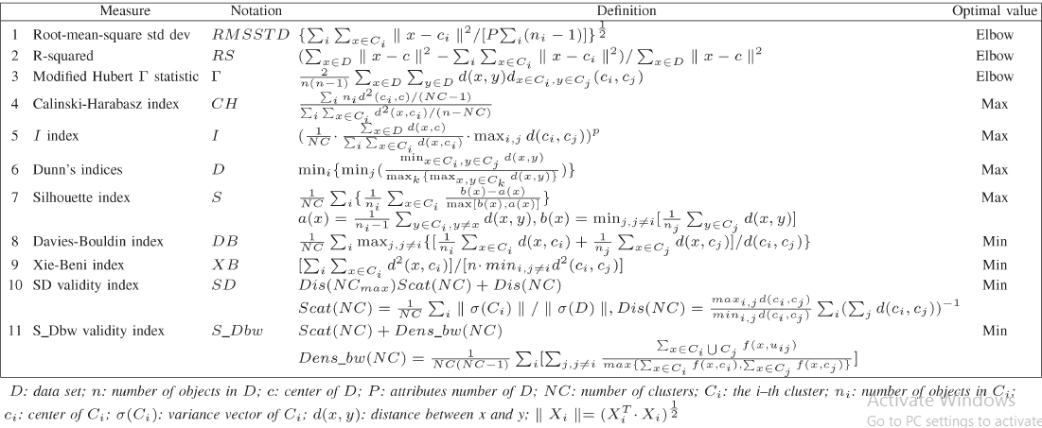
11 widely used internal validation measures

Slide 8
Clustering Validation index based on Nearest Neighbors (CVNN)
This measure consists of two components which measures intercluster separation and intracluster compactness, respectively.
We refer to the idea of k-nearest neighbor (kNN) consistency and propose an index by using dynamic multiple objects as representatives for different clusters in different situations when measuring the intercluster separation.

Slide 9
Internal Clustering Validation Measures
The measures are based on two criteria:
Compactness:
It measures how closely related the objects in the cluster are.
Seperation:
It measures how distinct or well separated a cluster is from other clusters.

Slide 10
Steps to determine best partition and optimal cluster number:
Initialize a list of clustering algorithms which will be applied to the data set.
For each clustering algorithm, use different combinations of parameters to get different clustering results.
Compute the corresponding internal validation index of each partition obtained in Step 2).
Choose the best partition and the optimal cluster number according to the criteria.

Slide 11
11 Widely Used Measures:
RMSSTD:
It is the square root of the pooled sample variance of all the attributes.
RS- R-squared:
It is the ratio of sum of squares between clusters to the total sum of squares of the whole data set.
Modified Hubert Γ Statistic:
It evaluates the difference between clusters by counting the disagreements of pairs of data objects in two partitions.

Slide 12
Calinski-Harabasz Index:
It evaluates the cluster validity based on the average between- and within-cluster sum of squares.
I Index:
It measures the separation based on the maximum distance between cluster centers and measures compactness based on the sum of distances between objects and their cluster center.
Dunn’s Index:
It uses the minimum pairwise distance between objects in different clusters as the intercluster separation and the maximum diameter among all clusters as the intracluster compactness.

Slide 13
K-means algorithm:
Randomly select ‘c ’ cluster centers.
Calculate distance between each data object and cluster center.
Assign the data object to the cluster center whose distance from the center is the minimum of all the cluster centers.
Recalculate the cluster center using v_{i=} (1/c_{i}) x_{i}
where c_{i} represents the number of data objects in i^{th} cluster &
x_{i} is the data object i.
Recalculate the distance between each data object and new obtained cluster centers.
If no data object was reassigned then stop, otherwise repeat step 3.

Slide 14
Understanding the Measures
Impact of Monotonicity
Impact of Noise
Impact of Density
Impact of Subclusters
Impact of Skewed Distributions
Impact ofArbitrary Shapes

Slide 15
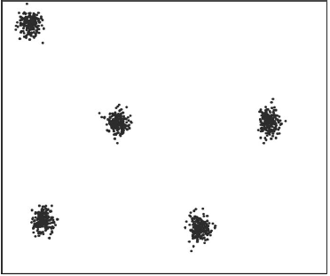
Impact of Monotonicity
K-Means clustering Algorithm is conducted on a data set and different clustering results are obtained.
The results show that the first three indices monotonically increase or decrease as the cluster number increases.
The rest eight indices reach their maximum or minimum
value as NC equals to the true cluster number.
Reasons?

Slide 16
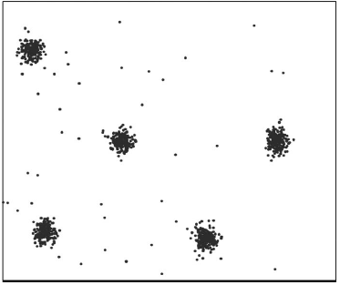
Impact of Noise
5% of noise is added to the data set and a synthetic data set is formed.
The experiment results show that D and CH choose the wrong cluster number.
Moreover, the other indices rather than CH and D will also be influenced by noise in a less sensitive way.
add 20% noise?
In order to minimize the adverse effectof noise,in practice,
it is always good to remove noise before clustering.

Slide 17
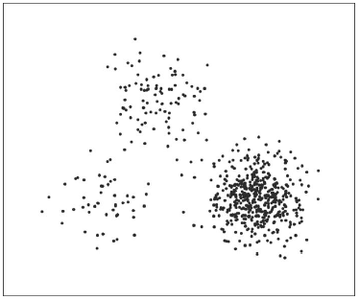
Impact of density
An experiment is done on a synthetic data set with different density.
The results show that only I Index suggests the wrong optimal cluster number and it keeps decreasing as cluster number increases.
One possible reason is uniform effect of K-means algorithm,
which tends to divide objects into relatively equal sizes.

Slide 18
Impact of Subclusters
Subclusters are clusters that are closed to each other.
The experiment is done to evaluate whether the internal validation measures can handle data set with subclusters.
For this data set, D, S, DB, SD, and XB get the wrong optimal cluster numbers, while I, CH, and S_Dbw suggest the correct ones.
Reasons are based on the criteria used by the index.

Slide 19
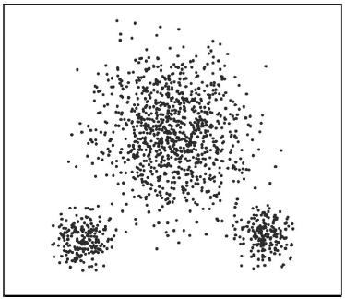
Impact of Skewed Distributions
An experiment is done on the data set Skewdistribution to evaluate the performance of different indices on data set with skewed distributions.
The experiment results show that only CH cannot give the right optimal cluster number.
Since K-means has the uniform effect which tends to divide
objects into relatively equal sizes, it does not have a good
performance when dealing with skewed distributed data sets.

Slide 20
Impact of Arbitrary Shapes
Experiments are conducted on data sets with arbitrary structures.
D uses the minimum pairwise distance between objects in different clusters to measure the intercluster separation.
For CH, I, DB, SD, S_Dbw, and XB these six indices use the cluster center of each cluster as the representative for that cluster when evaluating the intercluster separation.
S uses the average minimum pairwise distance between objects in each cluster as the separation measurement, which can be viewed as equivalent as the minimum pairwise distance between cluster centers in a sense.

Slide 21
Enhancement of CVNN Measure
Clustering Validation index based on Nearest Neighbors.
A new Internal validation measure is proposed based on the notion of nearest neighbors.
It is complementary to the existing measures.
Based on
Intercluster Seperation
Intracluster Compactness
CVNN Index

Slide 22
Intercluster Seperation
Let C_{i} and C_{j} be two clusters in a data set, c_{i} and c_{j} be the cluster centers of C_{i} and C_{j} , and n_{i} and n_{j} be the numbers of objects in C_{i} and C_{j} , respectively. The following are the six classes.
I) Sep(C_{i}, C_{j} ) = min _{x∈Ci,y∈Cj} d(x, y).
II) Sep(C_{i}, C_{j} ) = max _{x∈Ci,y∈Cj} d(x, y).
III) Sep(C_{i}, C_{j} )=(n_{i} · n_{j} )⁻¹ Σ_{x∈Ci,y∈Cj} d(x, y).
IV) Sep(C_{i}, C_{j} ) = d(c_{i}, C_{j} ).
V) Sep(C_{i}, C_{j} ) = max{δ(C_{i}, C_{j} ), δ(C_{i}, C_{j} )}, where δ(C_{i}, C_{j} ) = max _{x∈Ci} {min _{y∈Cj} d(x, y)} and δ(Cj , Ci) = max _{y∈Cj} {min _{x∈Ci} d(x, y)}.
VI) Sep(C_{i}, C_{j} ) = Dens(c_{ij} )/ max{Dens(c_{i}), Dens(cj )},
where c_{ij} is the midpoint of ci and cj and Dens(c) is the density of c, usually computed by counting the number of objects within a certain distance from c. Looking deeper into these six categories, we C_{i}

Slide 23
Cluster kNN Consistency
For any data object in a cluster, its kNNs should also be in the same cluster.
Here we propose a new measurement of the intercluster separation based on the notion of nearest neighbors-”Intercluster Seperation”.
Intercluster Seperation(Sep)
Sep(NC, k) = max _{i=1,2,...,NC}((1/n_{i}) Σ _{j=1,2,...,ni} (q_{j}/k)).
NC is the cluster number, k is the number of nearest neighbors, n_{i} is the number of objects in the i^{th} cluster C_{i}, O_{j} is the j^{th} object in C_{i}, and q_{j} is the number of nearest neighbors of O_{j} which are not in cluster C_{i}.

Slide 24
We define the intercluster separation mainly in four steps.
First, for each object in each cluster, find out whether at least one of its kNNs is in other clusters.
Second, for objects with positive answers, assign a weight to each of them (q_{j}/k). These are the objects that best represent for the entire clusters; for objects with negative answers, the weight is zero.
Third, calculate the average weight of objects in the same cluster.
Finally, take the maximum average weight among all clusters as the intercluster separation.

Slide 25
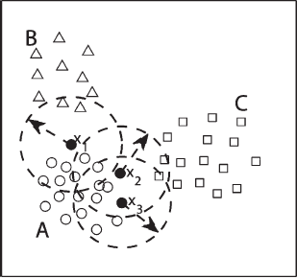
Example of intercluster Seperation calculation

Slide 26
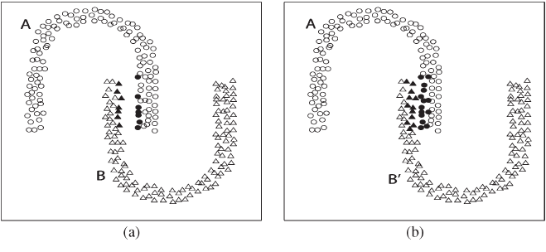
Illustration of the dynamic effect of cluster representatives. (a) Before movement.
(b) After movement

Slide 27
Intracluster Compactness
Existing validation measures of intracluster compactness can be categorized into the following five classes.
Let C_{i} be one cluster in a data set, x and y be the two different objects in C_{i}, c_{i} is the cluster center of C_{i}, and n_{i} is the number of objects in C_{i}. The following are the five classes.
I) Com(C_{i}) = (1/n_{i})Σ_{x∈Ci} d2(x, c_{i}).
II) Com(C_{i}) = max _{x,y∈Ci} d(x, y).
III) Com(C_{i}) = (2/n_{i} · (n_{i} − 1))Σ _{x,y∈Ci} d(x, y).
IV) Com(C_{i}) = (1/n_{i})Σ _{x∈Ci} d(x, c_{i}).
V) Com(C_{i}) = σ(C_{i}).

Slide 28
Intracluster compactness(Com)
Com(NC) = Σ i[(2/ n_{i} · (n_{i} − 1))Σ _{x,y∈Ci} d(x, y)].
where NC is the cluster number, n_{i} is the number of objects in the i^{th} cluster C_{i}, and x and y are two different objects in C_{i}.
This measure is mainly based on the average pairwise distance between objects in the same cluster.

Slide 29
CVNN Index:
Based on the intercluster separation and intracluster compactness, we have the definition of our internal CVNN.
CVNN Index: CVNN(NC, k) = Sep_{norm}(NC, k) + Com_{norm}(NC),
where Sep_{norm}(NC, k) = Sep(NC, k)/(max_{NCmin≤NC≤NCmax} Sep(NC, k)) and Com_{norm}(NC) =Com(NC)/(max _{NCmin≤NC≤NCmax} Com(NC)).
Here we normalize them to the same range before adding them up, since they should have the same order of magnitude.

Slide 30
?

